Slide 1
Identifying and visualising tonality/emotion and geographical information in the text of ECA Special Reports using IBM Watson and Tableau
25 July 2018
Zsolt VARGA, ECA.SEC-GEN.SG3.HU
zsolt.varga@eca.europa.eu
Notes:
Question: How can we visualise connections between countries and reports?
Scope: The textual content of the reports (country references in the text itself)
Data collection based on a pre-defined list of keywords (country names)
Automated entity recognition using machine learning libraries
Semi-manual collection using our internal information systems

Slide 2
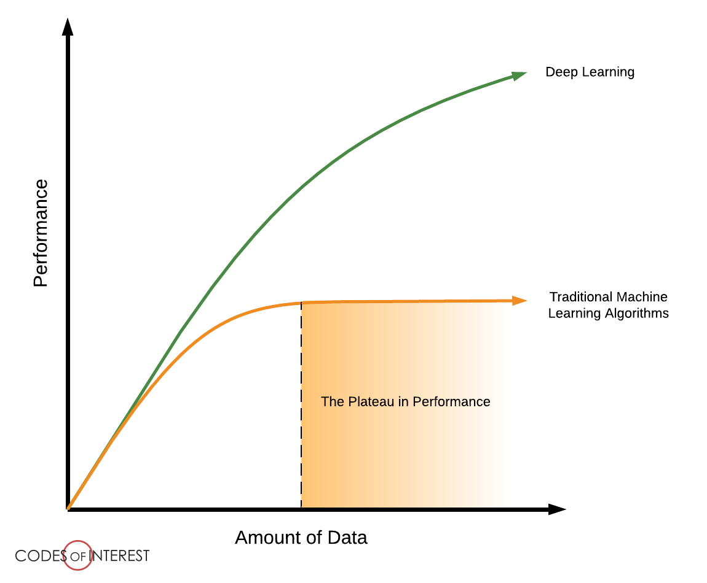
Neural vs. Traditional
You need LOTS of training data or a good pre-trained model to benefit from DL!
Traditional models/tools still work fine for certain tasks. No need for a cow to put cream into your coffee.

Slide 3
Text mining pipeline
Pre-process documents
Perform linguistic analysis
Quantify features in a data table
Visualise in Excel/Tableau
Named Entity Recognition
Vocabulary analysis
Sentiment analysis
Page 3

Slide 4
Geo-coverage of ECA special reports
Page 4

Slide 5
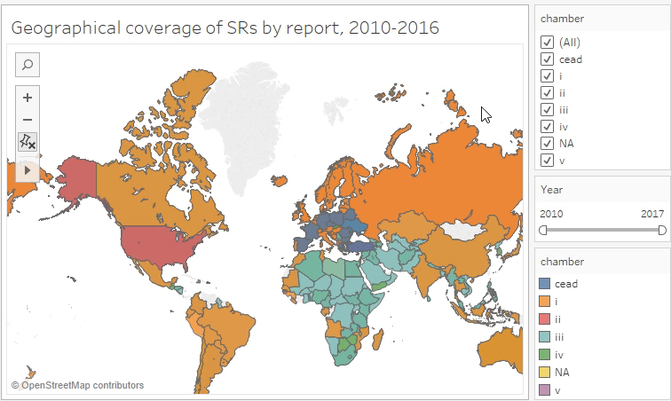
Geo-coverage based on report content
Notes:
Our Special Reports contain lots of references to Member states and third countries. These can be automatically identified in the text and visualised on a world map. This is called geo-coverage, and can be potentially very useful for research and preparatory work.
NA refers to reports adopted by the College of ECA Members, joint reports from more Chambers or reports where the adoption text did not refer to any Chambers.

Slide 6
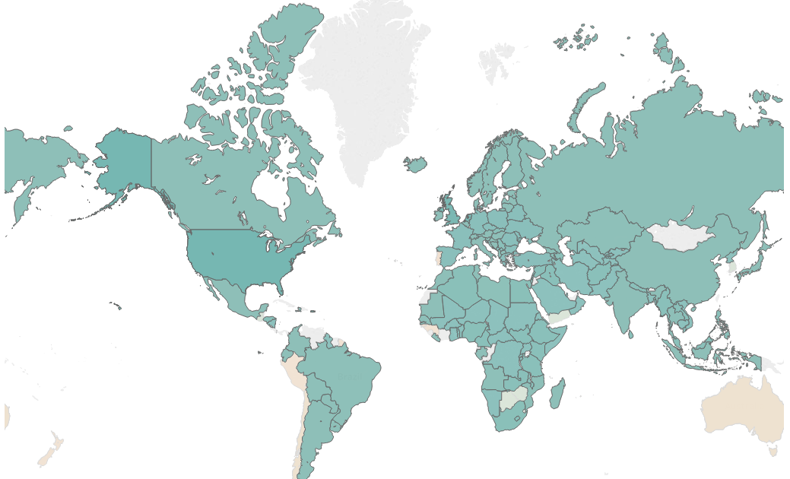
Geo-coverage based on report content (2010-2016)
Chamber III seems to cover the whole world!
Notes:
This map chart is based on the text of the reports. It does not mean that visits or in-depth reviews have taken place, only that references to a country have been identified by IBM Watson in the report text. The report numbers, report titles, country names and chamber numbers were all extracted from the text itself. Let's see for example Chamber III.

Slide 7
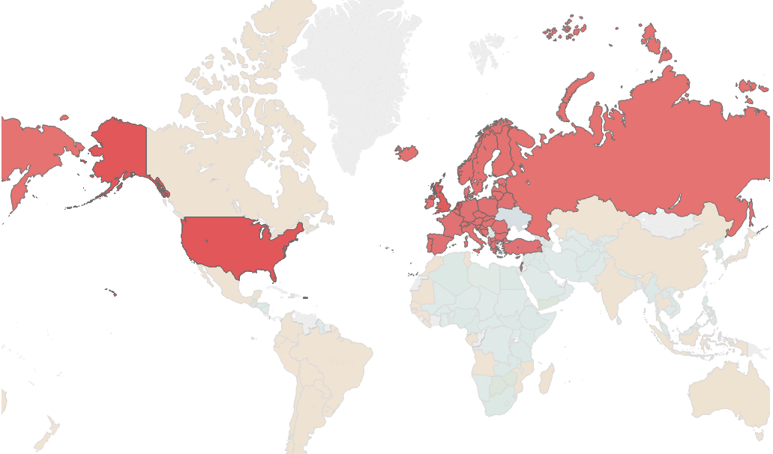
Geo-coverage based on report content (2010-2016)
Chamber II is more focused on Europe and our partners, the USA, Turkey and Russia
Notes:
While Chamber III covers almost all countries in the world, Chamber II is more focused on Europe and our partners, the USA, Turkey and Russia. The geographical focus can be further restricted by year of publication to see how the geographical scope of our reports change with time.

Slide 8
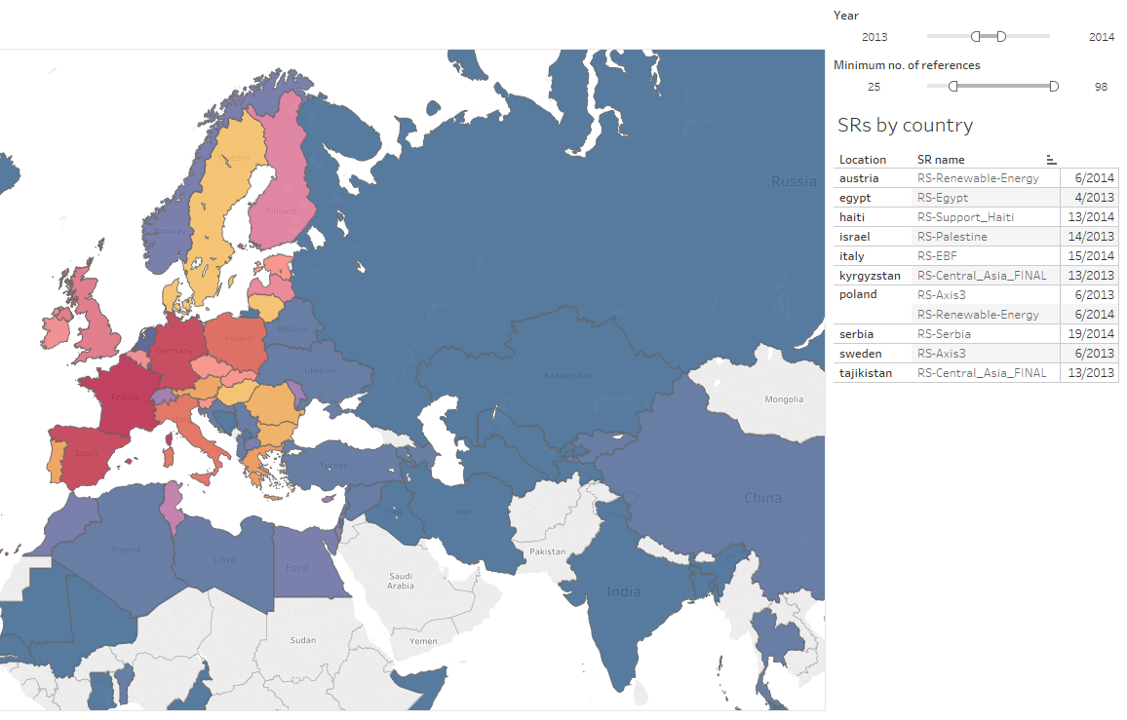
Geo-coverage based on report content (2013-2014, min. 25 refs)
Countries covered in 2013-2014
Countries mentioned at least 25 times
Notes:
In addition to years, we can also filter countries by number of references. If we take the 2013-2014 period and see which countries are mentioned at least 25 times, we get the list of countries and reports on the right side.

Slide 9
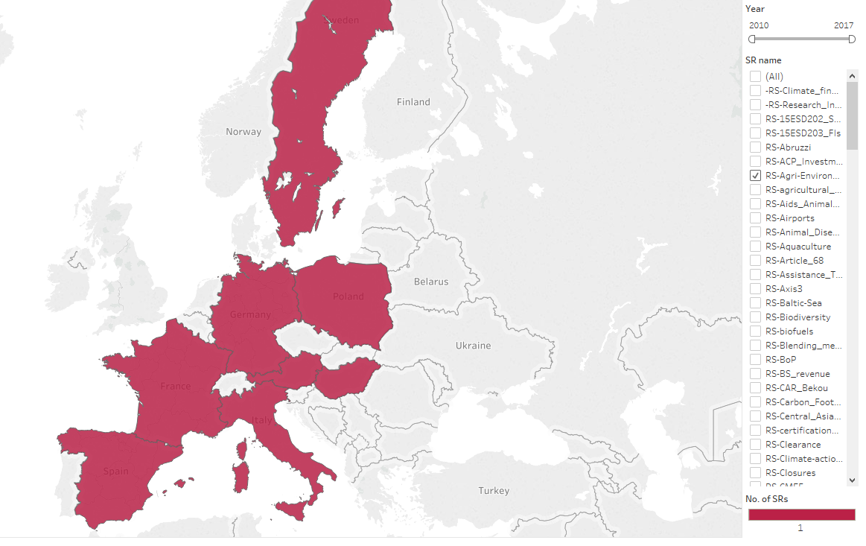
Geo-coverage based on report content (2013-2014)
Countries covered by SR Agri-Environment
Filtering geo-coverage by specific report(s)
Notes:
It is also possible to check for one specific report. The map below shows the countries mentioned in RS Agri-Environment.

Slide 10
Enrichment with existing metadata (proxies vs „real” variables)
Page 10

Slide 11
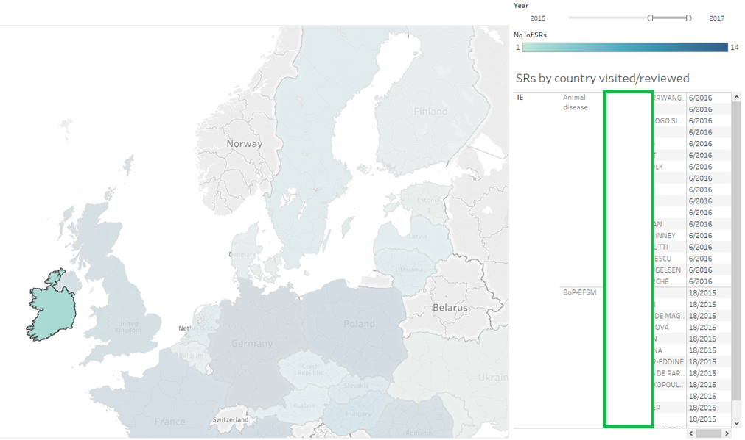
Geo-coverage + persons associated with reports
Auditors who worked on Ireland-related topics in the 2015-2017 period
Notes:
Example: let's look at reports that visited/reviewed Ireland in 2015-2017. There are two, written by the colleagues listed above.

Slide 12
Tonality and emotion in ECA special reports
Page 12

Slide 13
Sentiment analysis based on SR summaries
At the current technological level sentiment analysis is unreliable on long texts.
The Executive Summary provides a general overview of the reports and sets the tonality
Subjectivity analysis was performed by a word-list based weighting method (SpaCy)
Sentiment and tonality analysis was done by IBM Watson, using a pre-trained ensemble model (SVM, multi-label classifier)

Slide 14
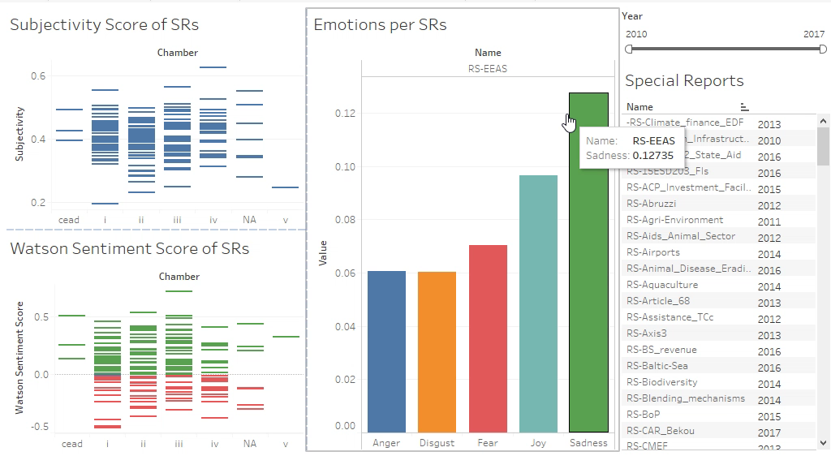
Sentiment analysis
Notes:
Sentiment analysis is the automatic analysis of texts for identifying tone and emotion. At the current technological level it is quite unreliable on long texts, therefore I used the executive summaries of SRs for this exercise.

Slide 15
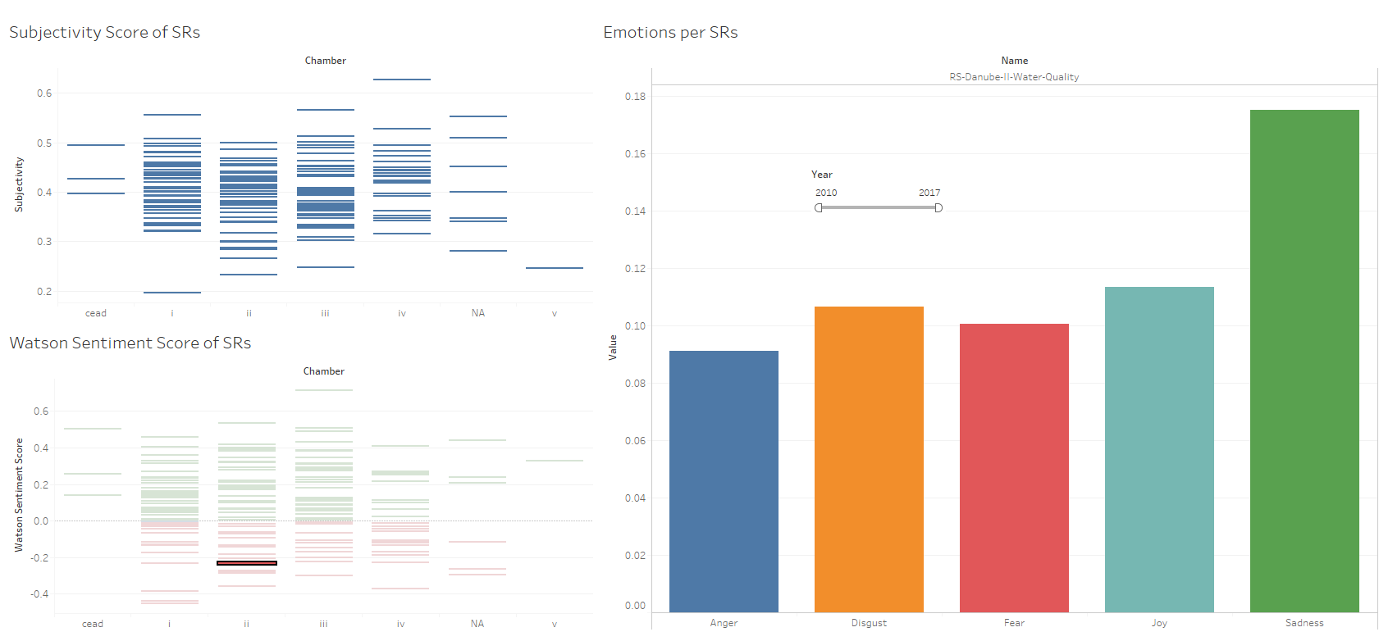
SR Danube II – Water Quality
Watson identified „Sadness” because we are missing things (there are deficiencies and problems)
Watson identified „Disgust” as a relevant emotion, because of wastewater-related words
Notes:
IBM Watson can also distinguish between 5 main emotions. This is still a bit experimental, but shows very interesting results. If we look at the Danube II Water Quality report, the high proportion of disgust is the result of wastewater-related vocabulary.

Slide 16
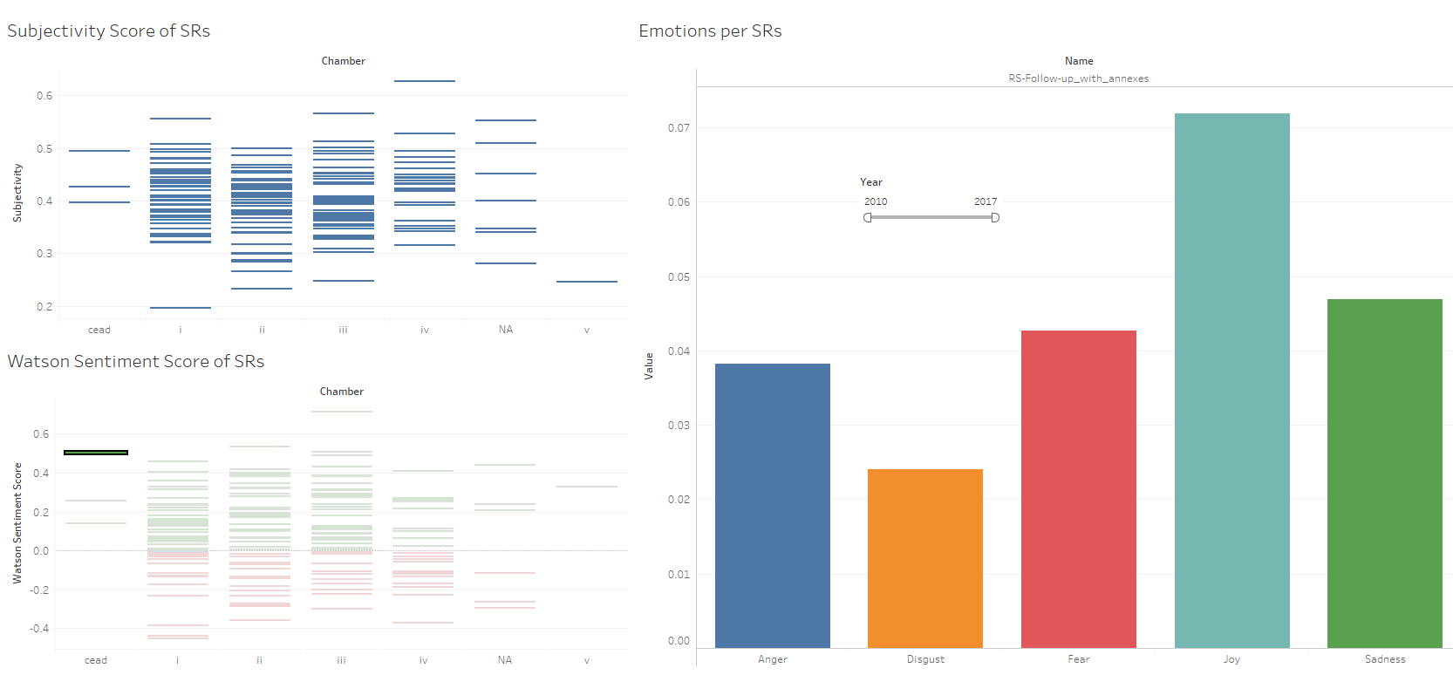
Follow-up report 2012
„Joy” because follow-ups acknowledge the results achieved
Notes:
Our reports often deal with deficiencies and problems, that are identified as anger and sadness. However, the summaries of our follow-up reports seem to be on the positive side.

Slide 17
Connecting all this together
Page 17

Slide 18
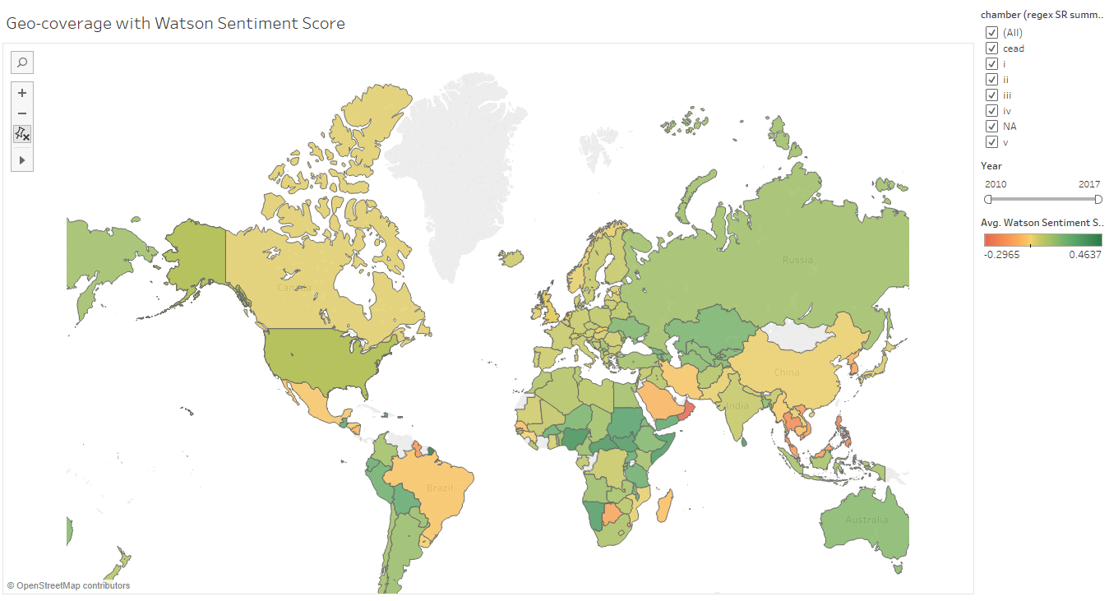
Geo-coverage with colours showing tonality

Slide 19
Closing remarks
Page 19

Slide 20
Typical dilemmas:
Off-the-shelf vs Custom developed
Free vs Commercial
Public/open vs Private/internal data
Artificial vs Natural intelligence ☺

Slide 21
Start small, think BIG! Find out if there’s a „data lab” or somebody already experimenting with text mining within your organisation and team up with them. If not, be a champion yourself!

Slide 22
What you need:
Python (Anaconda distribution) and the SpaCy library
IBM Watson Natural Language Understanding (free tier cloud access)
Tableau (trial version)
Documents you want to analyse (convert them to plain text format beforehand and make sure they are not classified)

Slide 23
QUESTIONS?
Email: zsolt.varga@eca.europa.eu
LinkedIn: www.linkedin.com/in/zsvarga/
GitHub: github.com/zseebrz
Tableau Public: public.tableau.com/profile/zsolt.varga#!/
(the scripts and visualisations will be published
on GitHub and Tableau Public soon)

